Slide 1



Automated testing of your Angular front-end
by Jago de Vreede and Robert Zwerus
Notes:
R
Bij intro noemen dat we ervan uitgaan dat je kennis hebt van HTML/CSS/Angular/JavaScript en dat we het over Protractor en een beetje TypeScript gaan hebben, maar daar geen voorkennis voor veronderstellen

Slide 2
Agenda
Introduction
About UI testing
Why does it fail so often?
What makes it a success?
Architecture of demo app
Live demo
Running on CI server
Conclusions
Presentation and sources available at:
https://github.com/Japio007/ProtractorDemo
Notes:
R

Slide 3

Quick question? Just ask!
Notes:
J

Slide 4


About us
Robert Zwerus
Jago de Vreede
http://www.luminis-technologies.com/
Notes:
R - J

Slide 5
UI testing (a.k.a. automated testing, end2end testing)
Test the entire system like a user would: by interacting with the front-end
Can serve as a quick test to see if anything got broken between deployments
Notes:
J
Q: Who already has experience with e2e testing?

Slide 6

UI testing: why does it fail so often?
Notes:
J

Slide 7
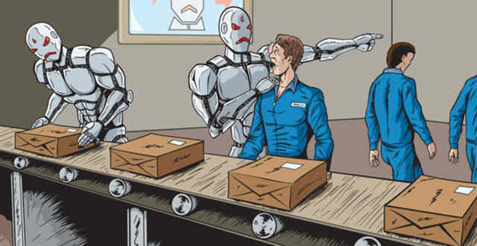
The machine can do only so much

Slide 8
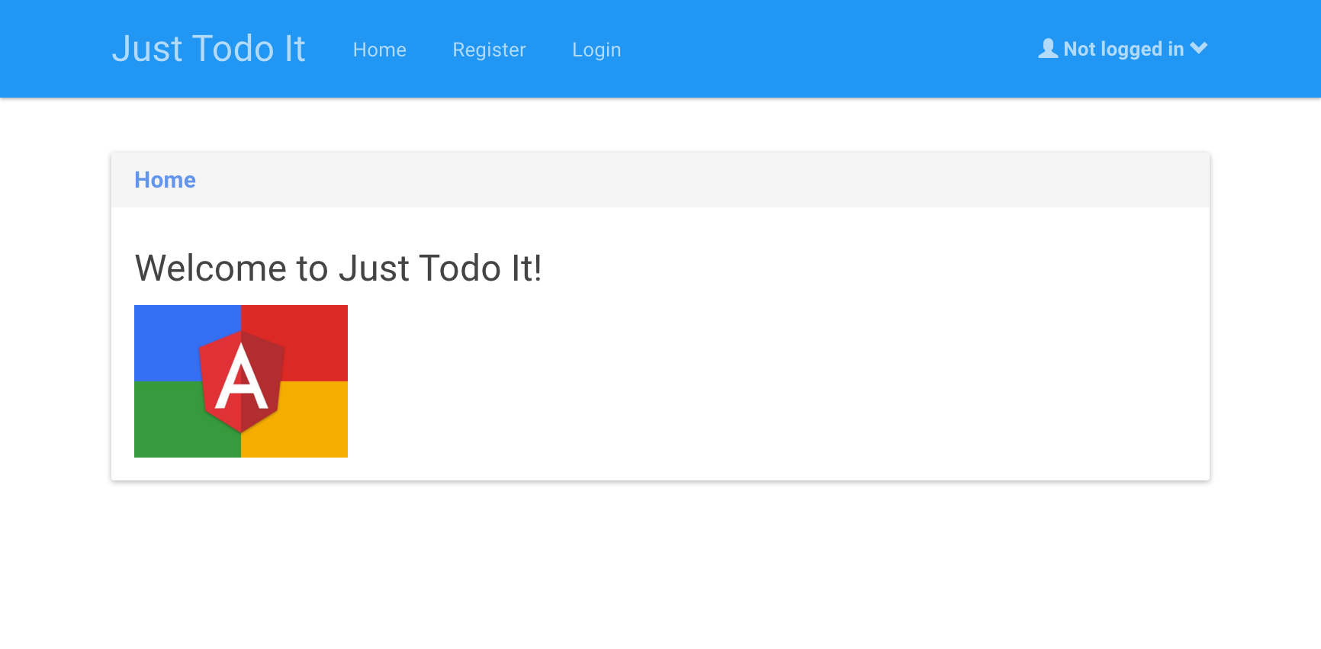
The machine can do only so much

Slide 9
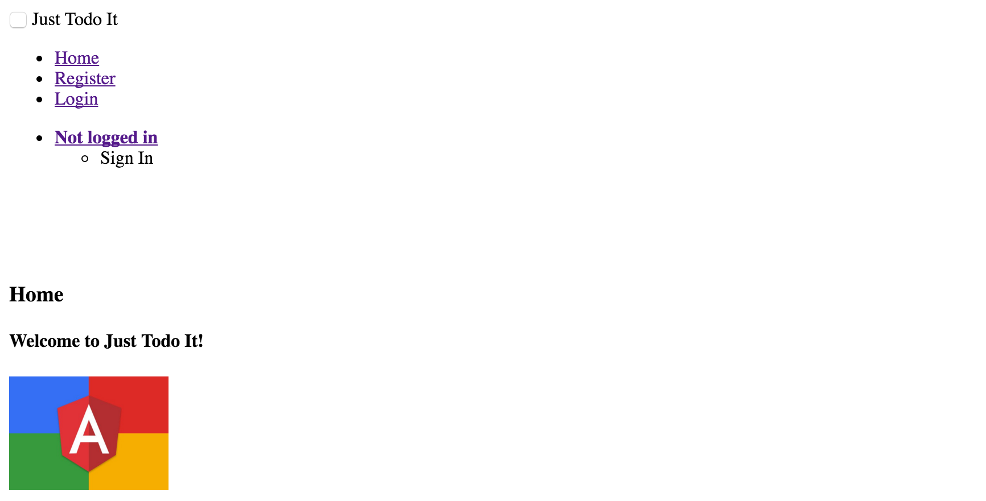
The machine can do only so much

Slide 10

UI testing: why does it fail so often?
Notes:
J
False hope that testers/req engineers will write+maintain tests Hard/impossible to write tests for complex use cases Lot of work maintaining tests

Slide 11
More reasons for failure
Almost every change breaks a test -> coupling too tight
Not ran often enough -> failures ignored
Recording tests from browser hardly works
Notes:
J

Slide 12
UI testing: what makes it a success?
Integrated in dev workflow
Integrated on CI server, run after each commit/PR merge
Suite runs quickly
Easy to pinpoint cause of errors
Notes:
R

Slide 13







high level architecture
HTML, Angular, TypeScript
RESTful webservices
OSGi Services
Apache Felix
Notes:
R
We use Amdatu, our opensource stack, but backend is irrelevant

Slide 14
TypeScript
ECMAScript 6
Compiles to JavaScript
Compile-time type checking
Code completion
Notes:
R
Q: who knows TypeScript?

Slide 15
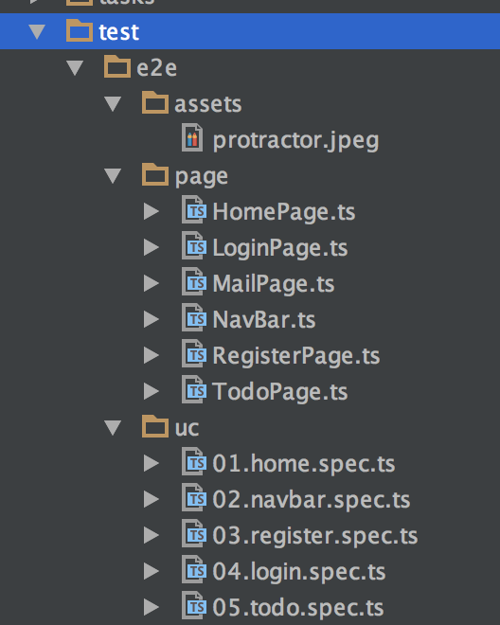
Test structure
Notes:
R

Slide 16
Page objects
Encapsulate information about a page
Reusable
Decouple the tests from implementations
Notes:
R

Slide 17
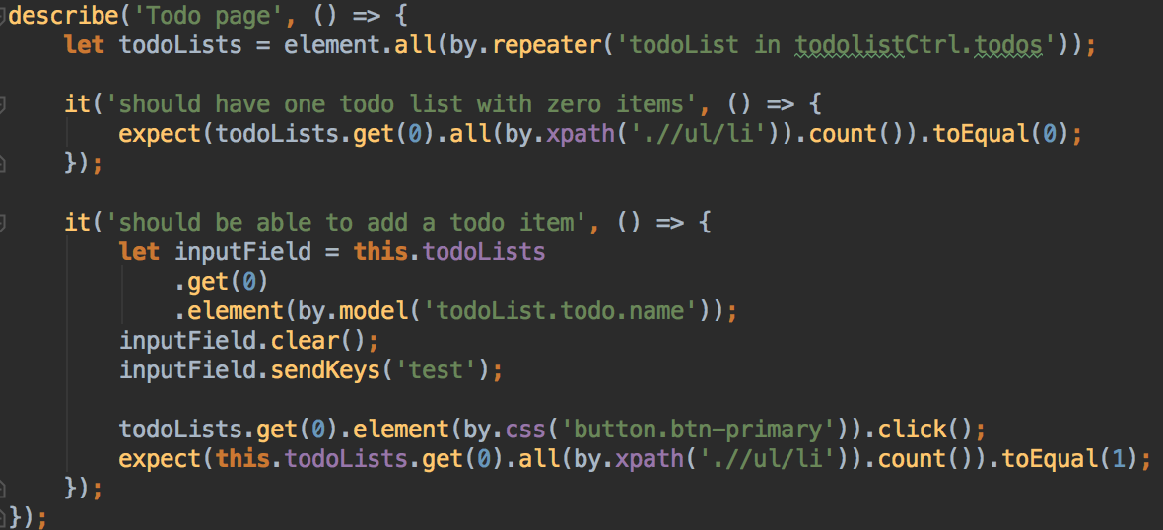
Without page objects
Notes:
R

Slide 18
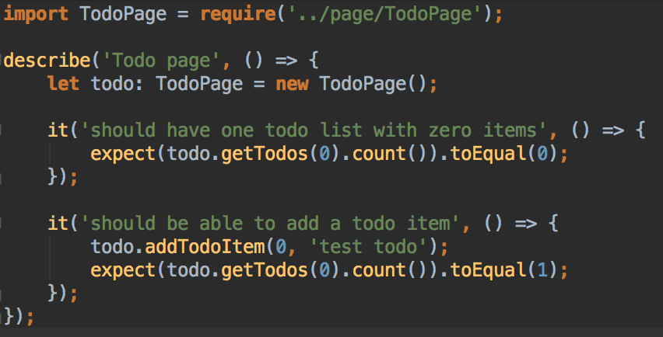
With page objects
Notes:
R

Slide 19
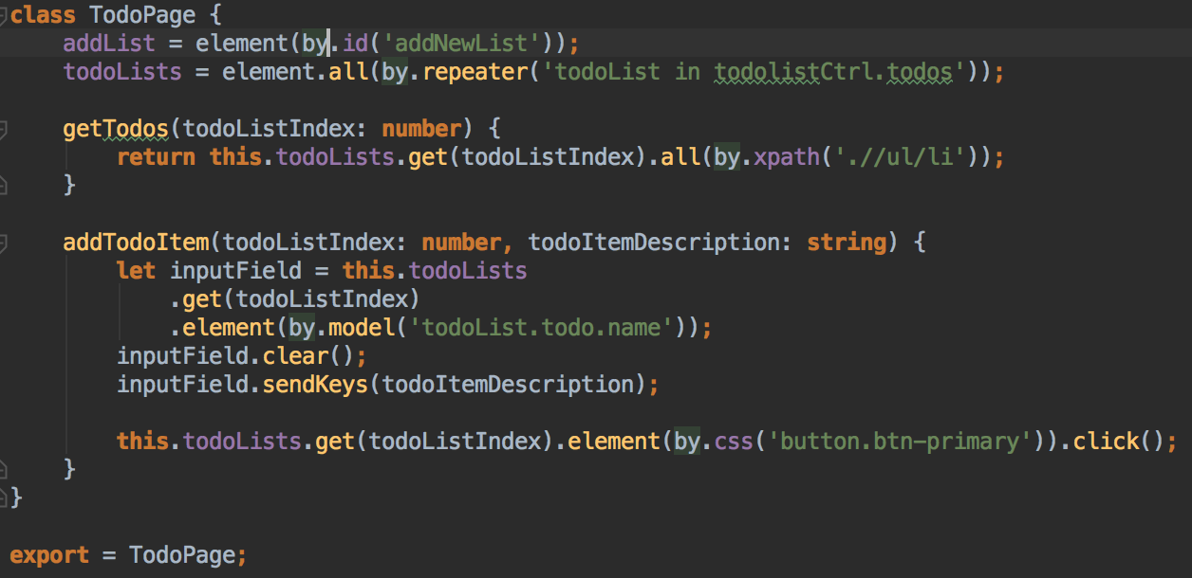
With page objects
Notes:
R

Slide 20

Demo time!
Notes:
R

Slide 21
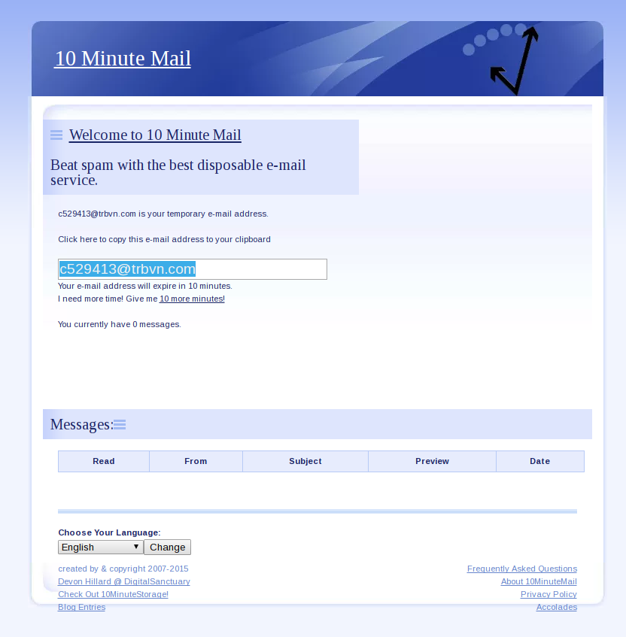
Notes:
J

Slide 22
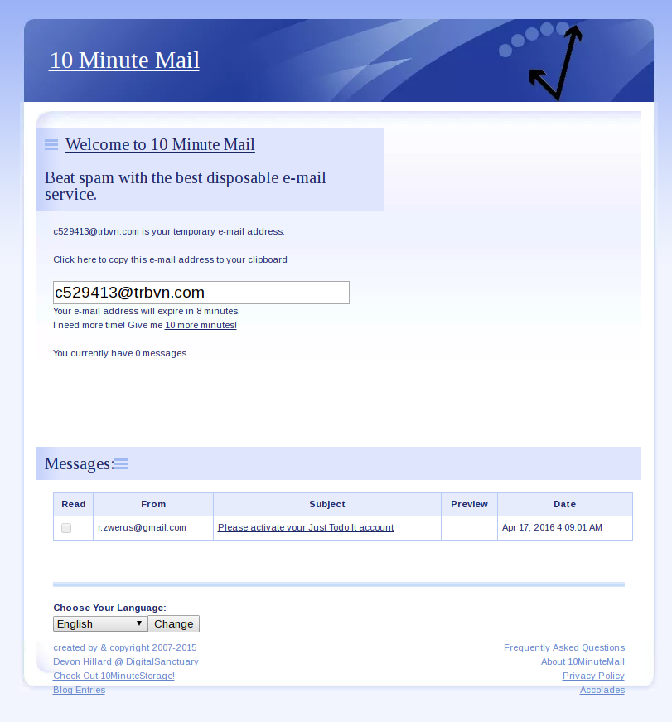
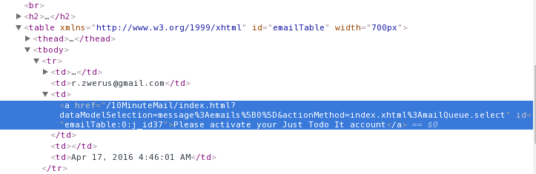
Notes:
J

Slide 23
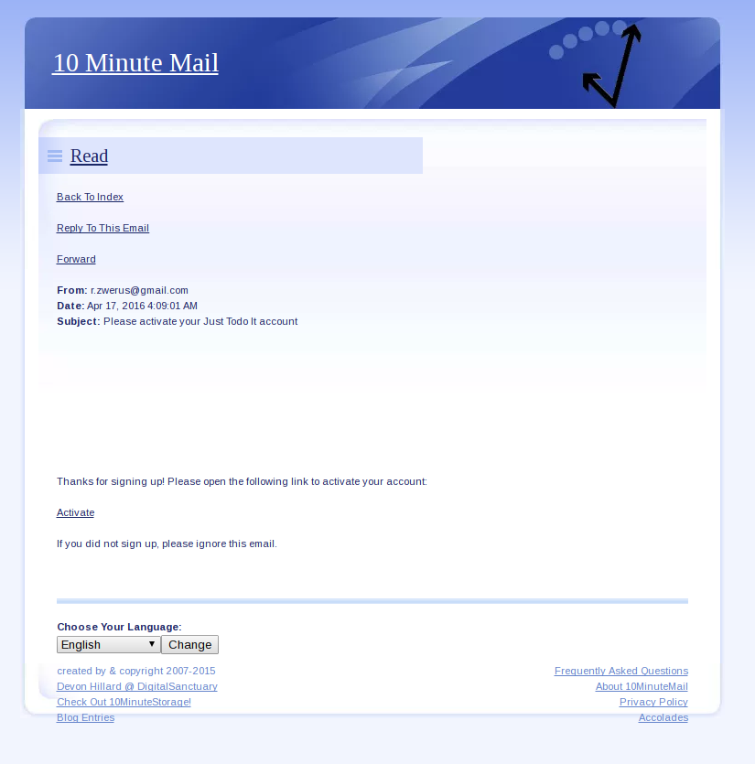
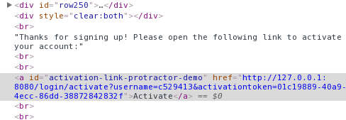
Notes:
J

Slide 24
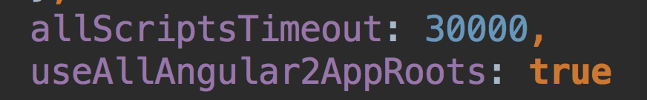
How about Angular 2?
Written in TypeScript
Created similar Todo app in Angular 2
Wrote some specs for it, works fine!
Notes:
R

Slide 25
Continuous integration
Requirements:
App running somewhere
Job on CI server
Hosted browser(s) somewhere
Notes:
R

Slide 26
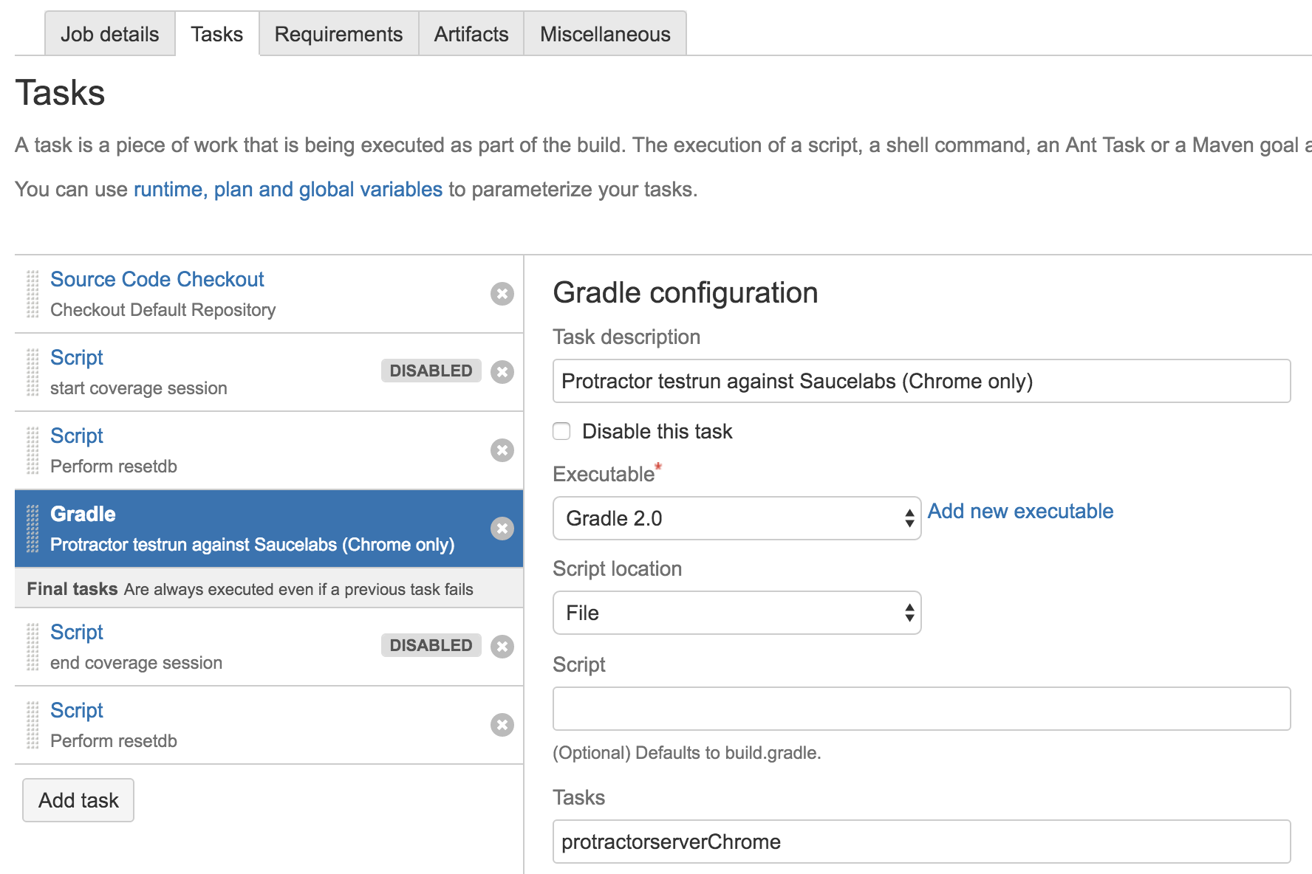
Notes:
R

Slide 27



Hosted browsers
Notes:
J

Slide 28
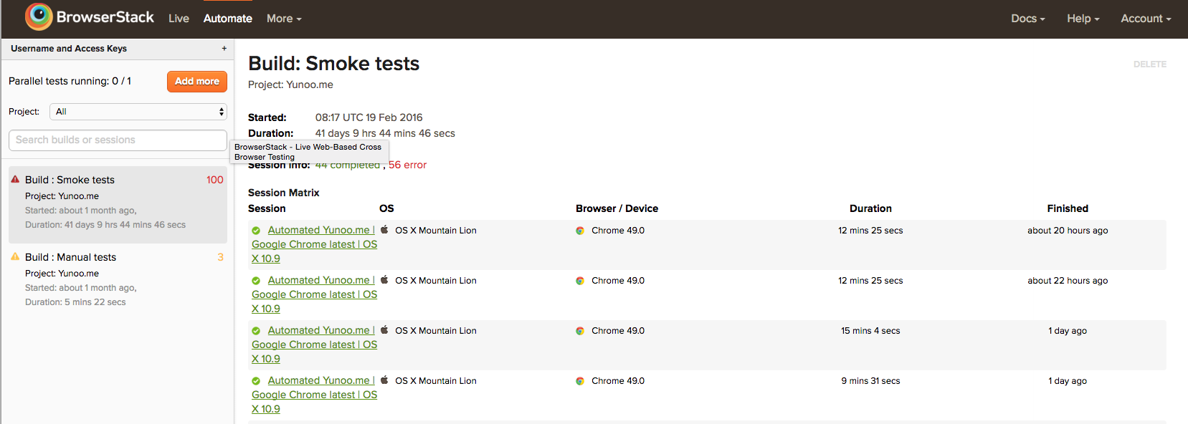
BrowserStack
Notes:
J

Slide 29
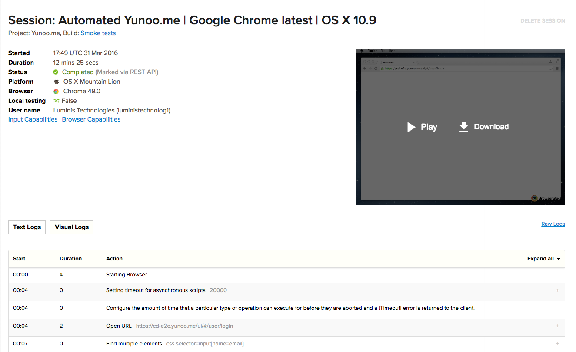
BrowserStack
Notes:
J

Slide 30

use smart, reusable locators
test outside app boundaries is possible
specs independent of each other
tests are code, so think about test structure
Notes:
J

Slide 31
No more excuses
GET TESTING!
Investment pays itself back in the long run
Even with low test coverage
Sometimes already while writing the tests
Notes:
J

Slide 32

Thanks, any questions?
Presentation and sources available at:
https://github.com/Japio007/ProtractorDemo
Don’t forget to vote!
Notes:
J

